Slide 1
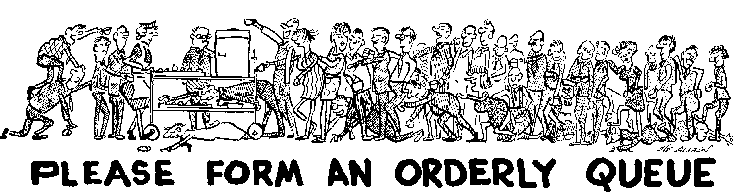

CANTEEN QUEUE MANAGEMENT (MINI PROJECT)
Under the Guidance of
Dr.C.Kiranmai
Professor, CSE
By
GV. Keerthana (19071A3227)
K. Rohan kumar(19071A3229)
P. Sahanya(19071A3243)
B. Pravardhan(19071A3244)
R. Sai Prudvish(19071A3248)

Slide 2

AGENDA
VNR Vignana Jyothi Institute Of Engineering and Technology
Computer Science & Engineering Department
Computer Science and Business Systems (CSBS)
Sno
1 | Introduction | 3
2 | Abstract | 4
3 | Existing system | 5
4 | Drawbacks of existing system | 6
5 | Proposed system | 7
6 | Objectives and Functionalities | 8
7 | System requirements | 9
8 | Literature | 10
9 | Work flow | 14
10 | UML diagrams | 15

Slide 3

INTRODUCTION
VNR Vignana Jyothi Institute Of Engineering and Technology
Computer Science & Engineering Department
During breaks, there is a huge crowd in the college canteen. Starting from the queue at the coupon counter to the serving counter a lot of time is spent waiting due to which the students and faculty get late for their lectures.
Both students and faculty, often wish to have a way to considerably reduce or get rid of this waiting time.
One solution to this problem is to have a system by which once the order gets placed a token will be generated for the item.
This would avoid the time wasted at the serving counter when a server takes time to deliver previous orders before taking a new coupon and placing it in the kitchen.
We can also have a facility for placing orders in advance so that his/her order is kept ready just for the particular time he/she chooses.
The time spent over tendering change can also be reduced by facilitating payments via e-wallet.

Slide 4
Abstract
In Canteen Management System we offer the canteen facility within the college campus. This process helps reduce the service time, long queues and avoids delayed orders. Normally, people need to go the canteen and order food and sit up for an extended time in an exceedingly queue for the order. But using this application you will order your food by just following a uncomplicated process. All the workers, teaching/non-teaching staff, Students can order their food without actually visiting the canteen and need not wait within the queue for an extended time.
Students can save time by ordering their food using this application. As students have limited time for his or her lunch and there are lot many students in canteen looking ahead to their orders they'll simply place order sitting within the class room and later get their order. They’ll also make payment online. As you've got logged in with your user-name and password, visit any tab and order your food . you will receive a token for that order. And while receiving you order just show the token and take your order directly at the serving counter need not wait at coupon counter.

Slide 5
Existing System
The existing system is a cash and paper based system. The payment and process takes a lot of time as the customer has to pay the exact amount and wait for the change.
The paper token is provided to the customer which should be shown at the serving counter.

Slide 6
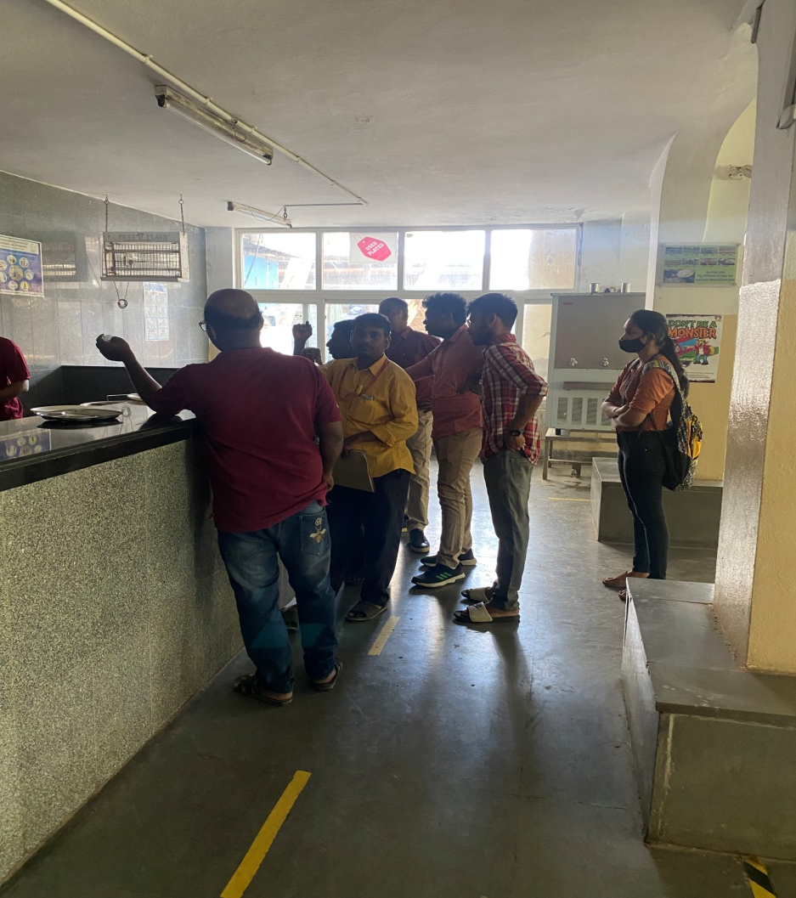
Drawbacks of Existing system
Huge crowd at the token counter and the serving counter.
Ample amount of time is
wasted.
Difficulty in paying with
cash due to crowd.

Slide 7
Proposed system
This system is generally advantageous for avoiding spending time waiting in the queue by posting orders directly to the kitchen without delay and also by scheduling orders ahead of time.
It saves time and also the technique dealing with is easy.
The proposed Canteen Management System is an adept solution for chaos at college canteens.
Highlights of cloud for example auto-scaling, load adjusting and pay as you go improve the working of the system and to some extent unravel the motivation behind the proposed system.

Slide 8
Objectives and Functionalities
To manage the details of Canteen, Students, Item, Stock.
To build an application program to reduce the manual work for managing the Canteen, Students, Customer, Item. It tracks all the details about the Item, Stock, Sales.
To Provide the searching facilities based on various factors such as Item, Stock, Sales.
To Manage the information of Canteen, Stocks & also Students.
Editing, adding and updating of Records is improved which results in proper resource management of Canteen data.
Integration of all records of Sales.

Slide 9
System Requirements
4 GB RAM
64 bit Operating system
Web Technology – Angular, NodeJS
Database – MySQL

Slide 10
LITERATURE
TITLE | YEAR OF PUBLICATION | MODEL | ADVANTAGES | LIMITATION
Analyzing the University Canteen Performance- Wayamba University of Sri Lanka | 21st Nov 2019 | The queuing system was modeled using the student version of Rockwell ARENA 14.5. | The findings suggested improving the customer service of the system by opening an additional counter during the lunch hour and redesigning the layout considering the financial feasibility | It is only related to the time constraints Nothing related to food orders.

Slide 11
International Journal of Innovative Technology and Exploring Engineering (IJITEE) | 7, May 2020 | The internet application would make use of HTML5, two Java script, two and Boot Strap for frontend and JSP for the backend. Appropriate protection aspects shall be implemented to prevent attacks the usage of 2048 bit El-Gamal encryption scheme. | The proposed software is effective in cutting the amount of time spent in the queue to send orders straight into the kitchen, placing orders before and with the option to use a card payment system that reduces time spent in tendering changes. | At times, server may come out to Be busy ,then payment cannot be done.

Slide 12
JETIR- Journal of Emerging Technologies ,Innovative Research | October 2018 | The design of the site has been done using the following technologies:- HTML, CSS, Ajax, Bootstrap, Angular JS, Java Oracle | The food will be ready in advance and the customers need not to wait near the delivery place. The digitalisation of the canteen system will be helpful in providing the better service to the users and the time consumption will be less | Http Server problem

Slide 13
International Research Journal of Engineering and Technology (IRJET)- ANDROID BASED CANTEEN MANAGEMENT SYSTEM | 04th Apr 2021 | The canteen uses the web application login to access the orders placed by the student. Created and maintained all databases into SQL Server, in that we create tables, write query to store data or record of project. | All the orders placed by the students will be in digital format hence no chance of human error and tedious work. Canteen workers will not have to remember each and every order placed make their task easy | Not secure

Slide 14
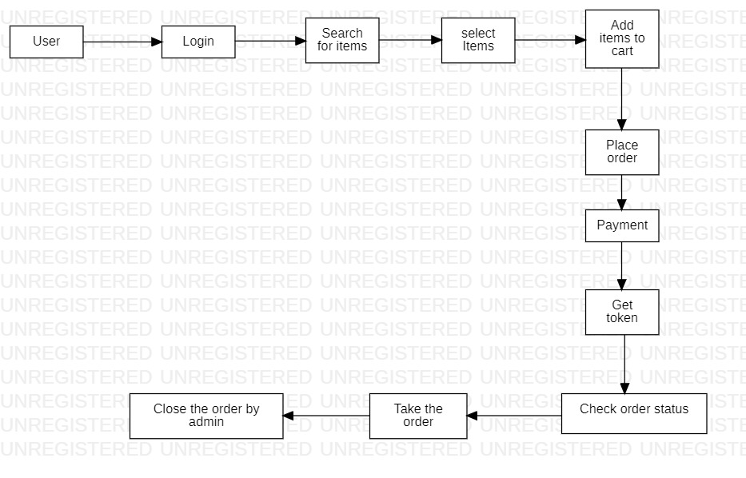
WORKFLOW

Slide 15
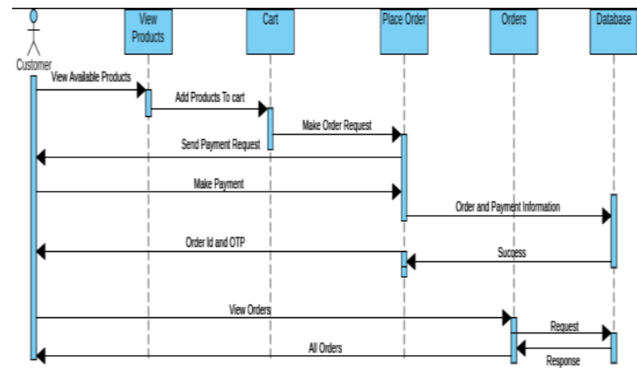
Sequence diagram for placing orders

Slide 16
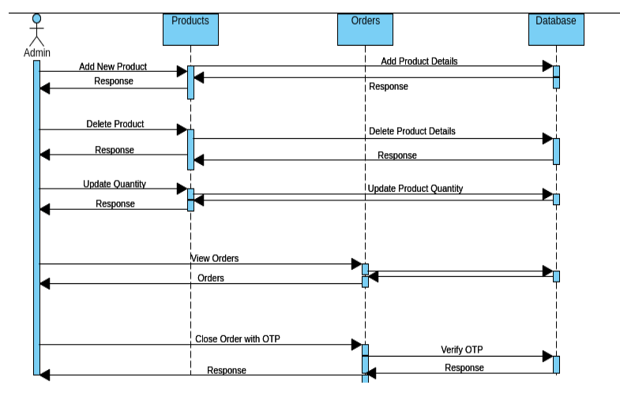
Sequence diagram for managing orders and products by admin

Slide 17
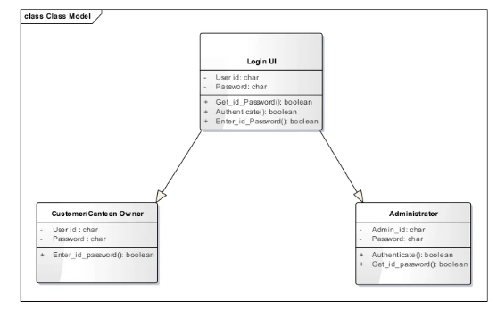
Class diagram for login process

Slide 18
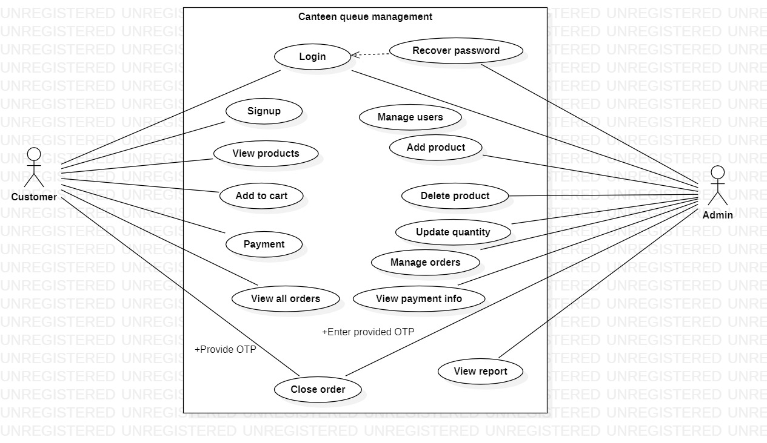
Use case diagram

Slide 19
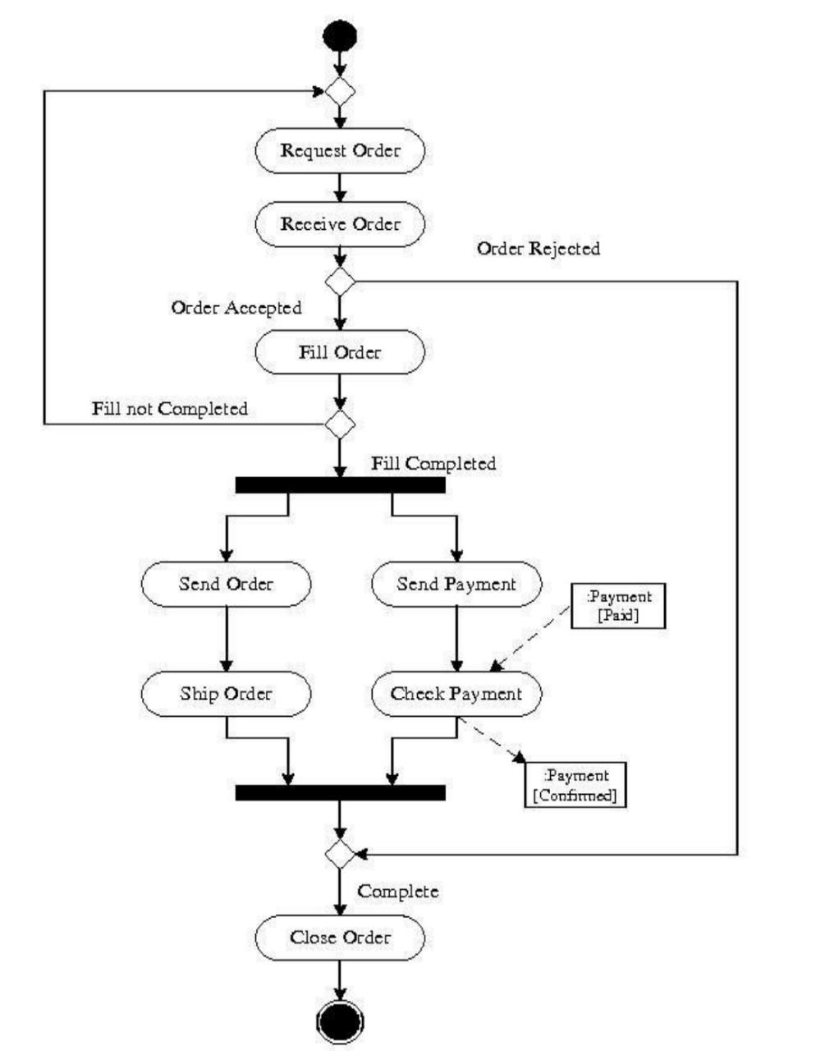
Activity diagram

Slide 20
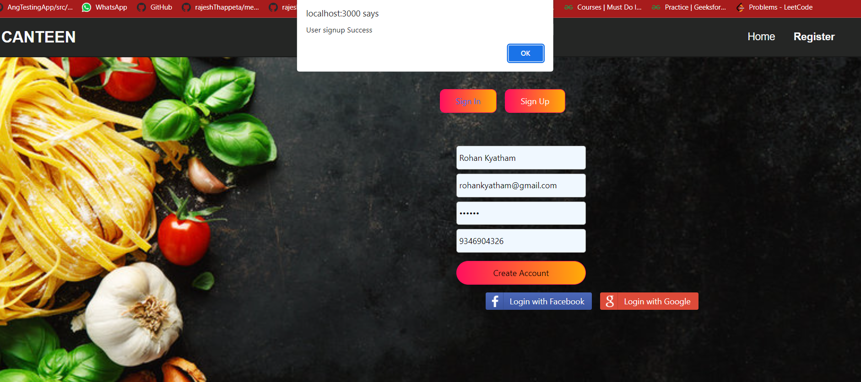
SIGN UP PAGE

Slide 21
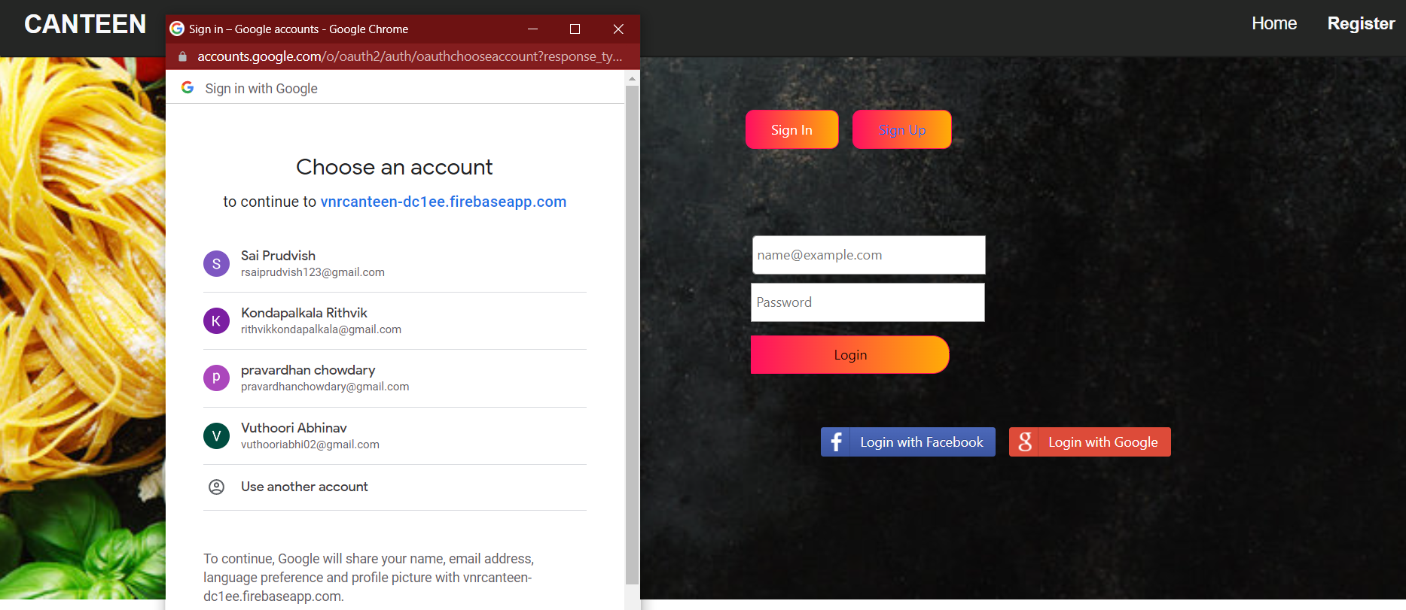
Authentication using Google and Email

Slide 22
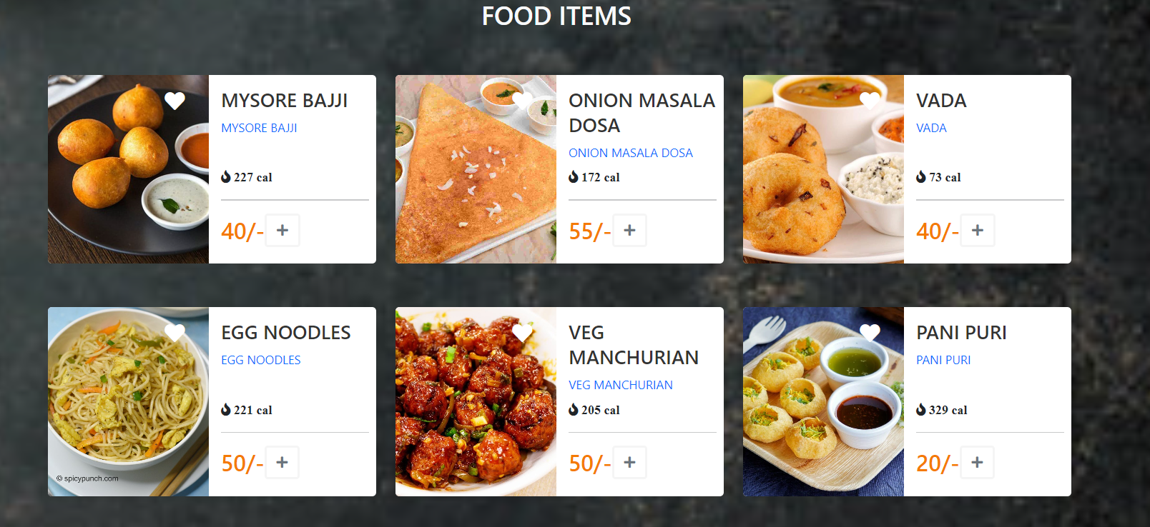
HOME PAGE- Displaying Menu

Slide 23
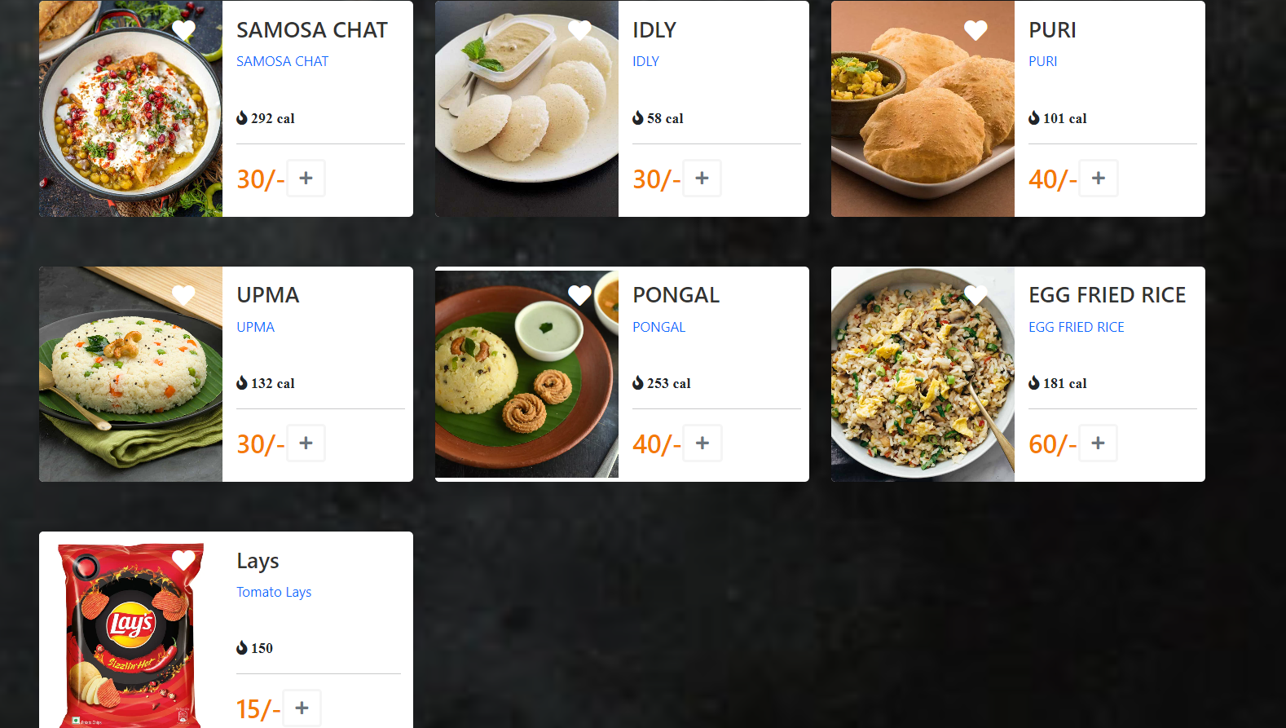

Slide 24
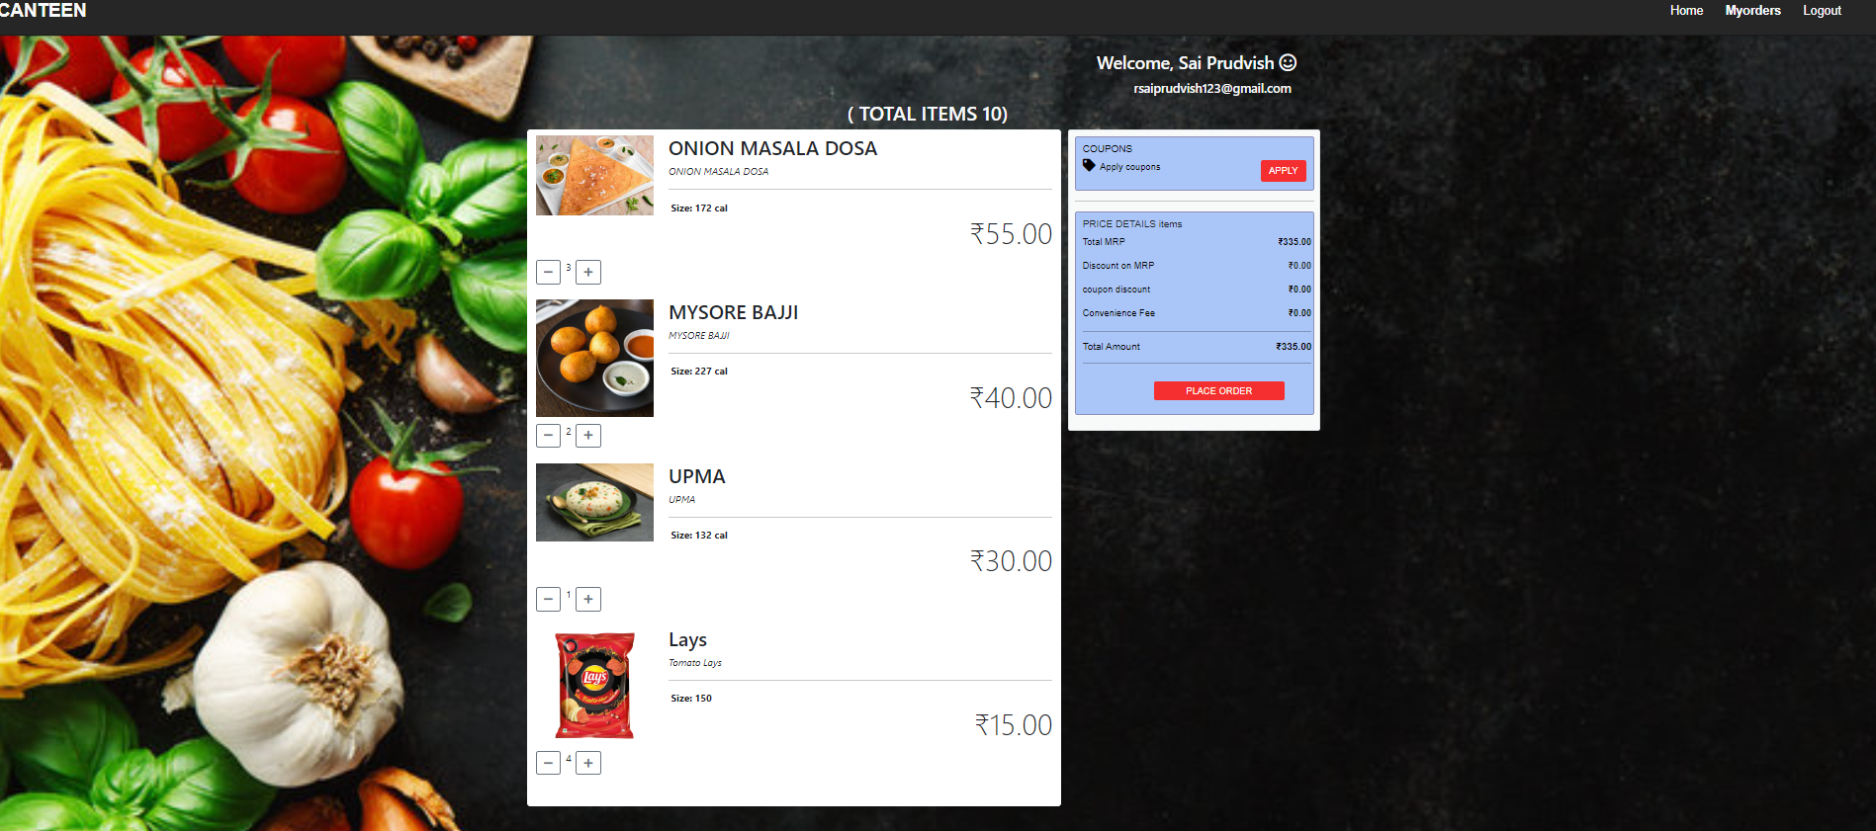
Add items to your Cart

Slide 25
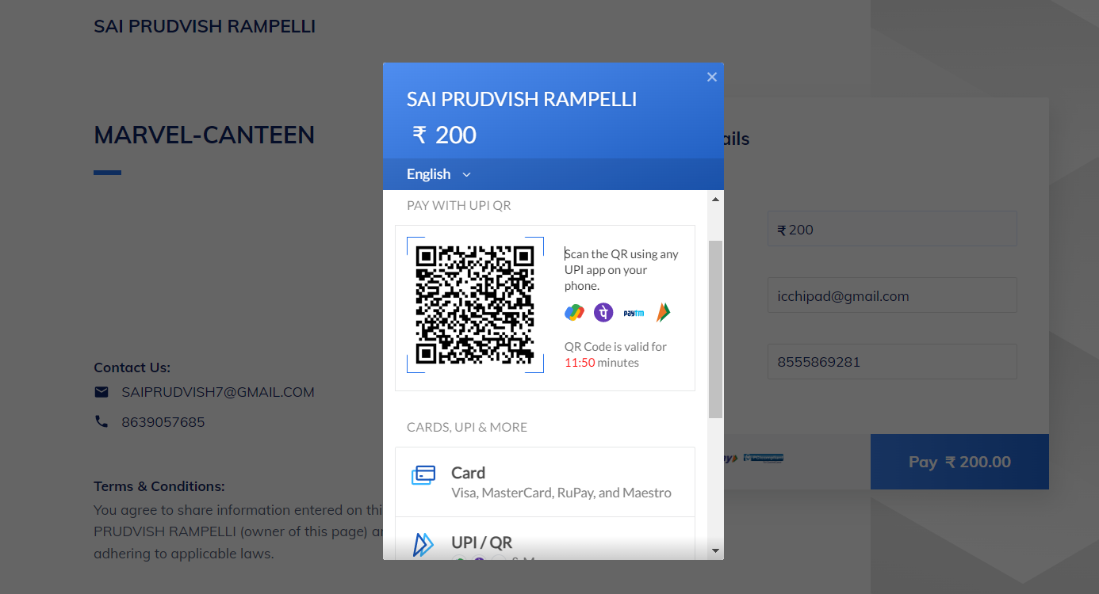
Payment

Slide 26
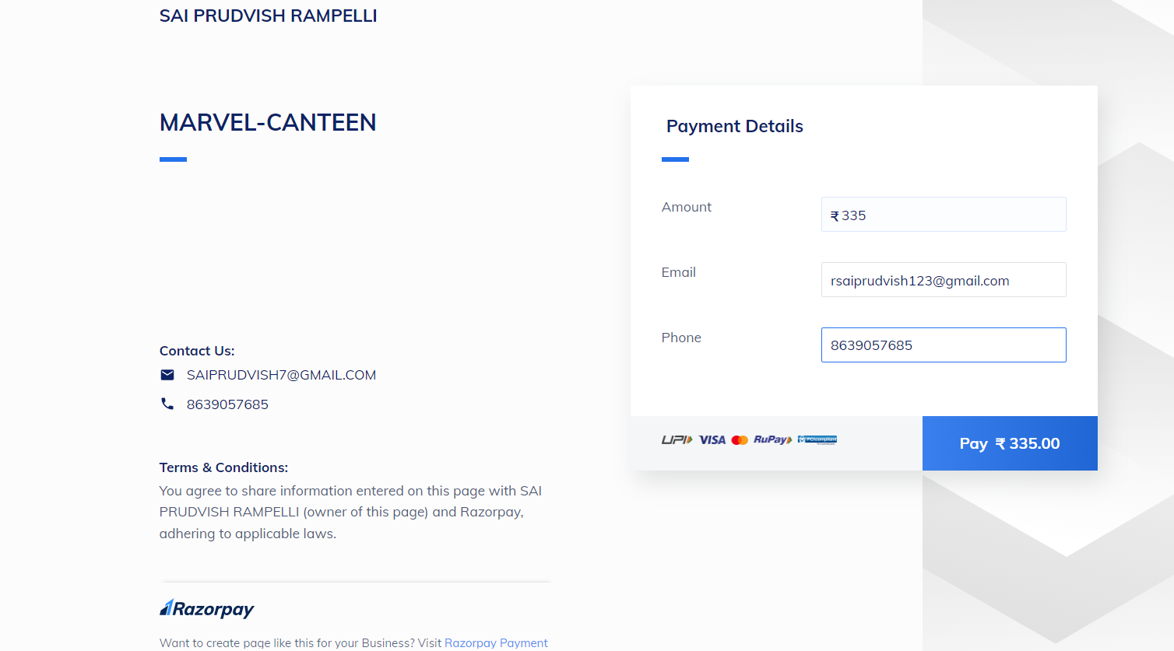
Enter details and pay

Slide 27
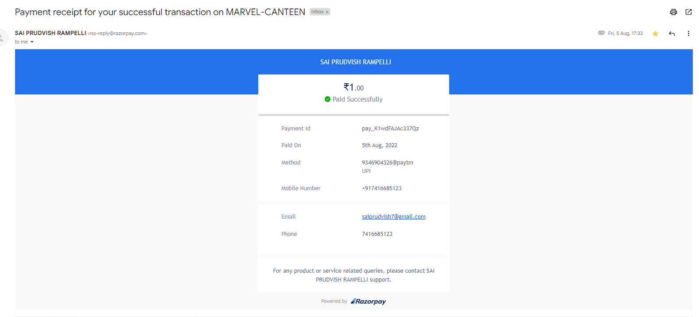
Receipt to mail after successful payment

Slide 28
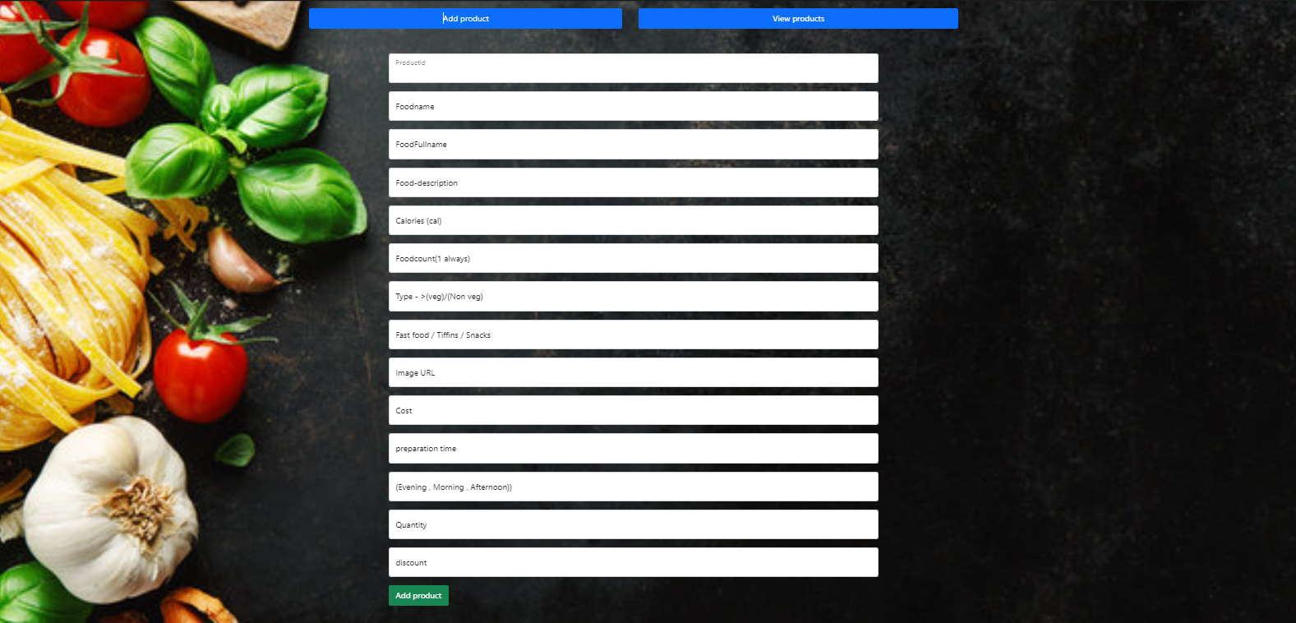
Admin adding products and managing stocks

Slide 29
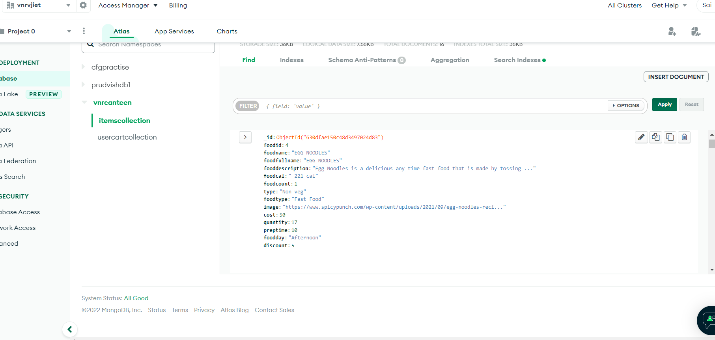
DATABASE

Slide 30
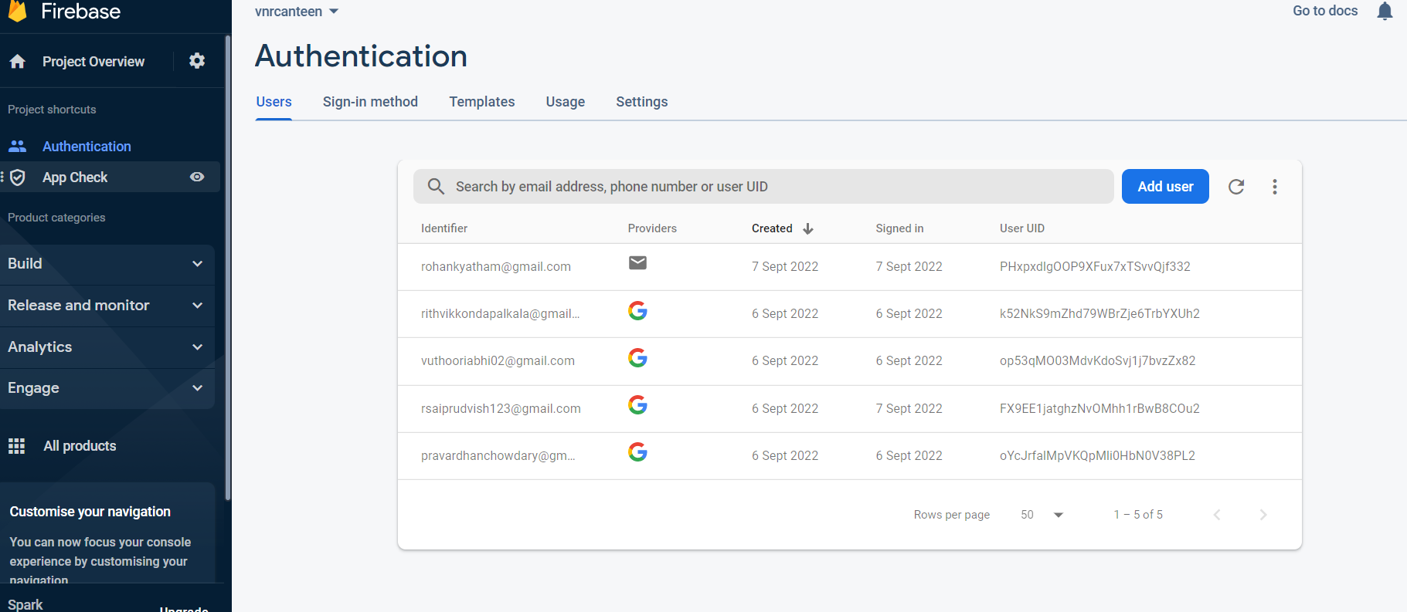
Authentication using Firebase

Slide 31
THANK YOU

